Slide 1
Lecture Roadmap
1
Will present image processing operations in turn then case studies:
Histograms
Point operations
Algebraic operations
Geometric operations
Convolution & spatial filtering
Fourier analysis & frequency filtering
Segmentation overview
Case studies (graduate students)

Slide 2
Algebraic Operations
OBJECTIVES
1. Define algebraic operations
2. Overview of applications
3. Averaging for noise removal **
4. Background removal**
Corresponds to parts of Chapter 7 (7.1, 7.3).

Slide 3
Algebraic Operations: Definition
+
=

Slide 4
Using MATLAB

Slide 5
Overview of Applications
Addition:
  averaging for noise reduction
M=1
M=2
M=4
M=16

Slide 6
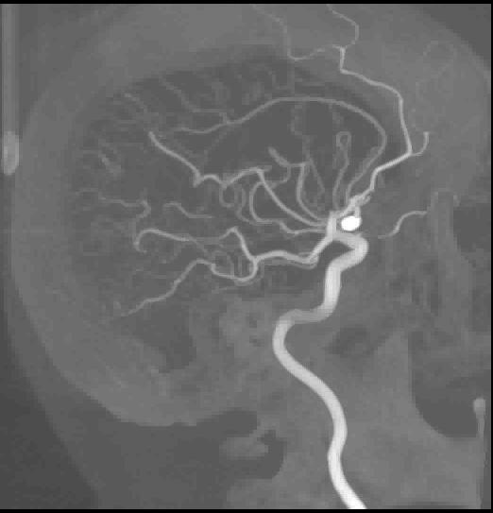
Overview of Applications
Subtraction:
  background removal**
  change/motion detection
  enhancement (e.g., digital subtraction angiography)
X-ray image obtained before and after injection of dye into arteries. Dye affects appearance of blood vessels but not surrounding tissues. Subtracting pre- and post-injection images enhances blood vessels relative to tissues. (Image courtesy of D. W. Holdsworth, RRI.)

Slide 7
Overview of Applications
Multiplication:
  masking used to zero out areas that you don’t want to use in calculations
(a)
(b)
x
(a) Magnetic resonance velocity image through the human neck. Multiplying by the mask in (b) isolates pixels corresponding to one of the carotid arteries. Averaging pixel values inside the masked region and multiplying by the area of the mask yields the average blood flow. (Image courtesy of D. A. Steinman, RRI.)

Slide 8
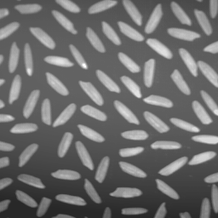
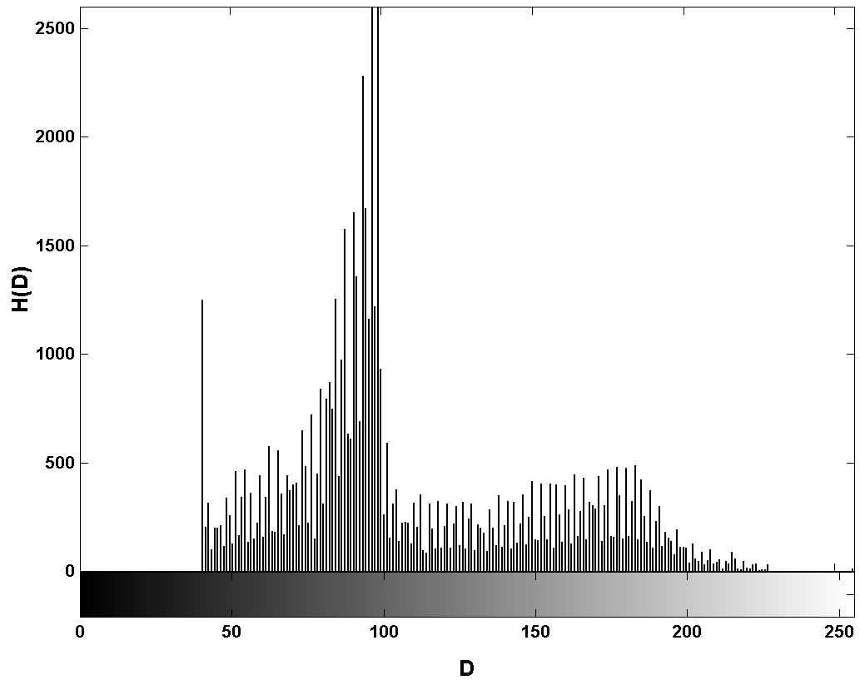
Background Removal/Levelling

Slide 9

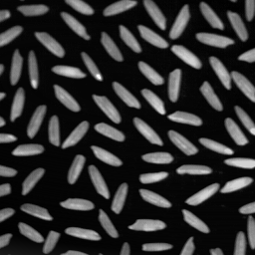
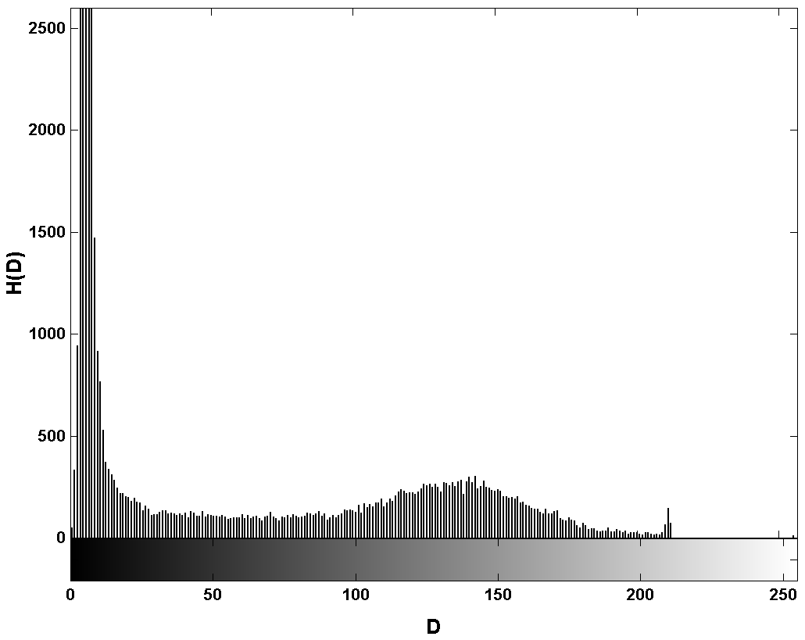
Background Removal/Levelling
(a)
(b)
(c)

Slide 10
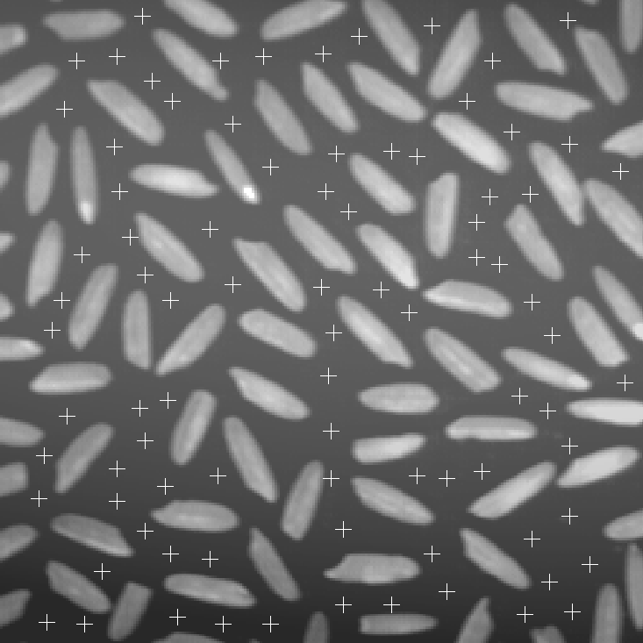
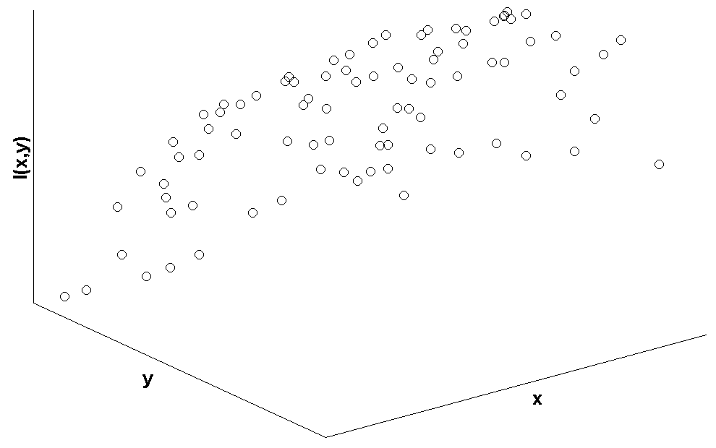
Background Removal/Levelling
x
y

Slide 11
Background Removal/Levelling
function [im2, a] = level( fname )
% …(comments removed)
% Read in image and display it
im = imread( fname );
imshow(im);
% Get user-selected points
disp('Select points using left mouse button. Press ENTER key when done.');
[x, y, I] = impixel;
I = I(:,3);
% Plot points
hold on; plot(x, y, 'y+'); hold off
.
.
.

Slide 12
Background Removal/Levelling
% Fit data at selected points to background function
% First, compute elements of the matrix [C]
N = length(x);
Sx = sum(x);
Sy = sum(y);
Sxx = sum(x.*x);
Syy = sum(y.*y);
Sxy = sum(x.*y);
Sxxx = sum(x.^3);
Sxxy = sum(x.*x.*y);
Sxyy = sum(x.*y.*y);
Syyy = sum(y.^3);
Sxxxx = sum(x.^4);
Sxxxy = sum(y.*x.^3);
Sxxyy = sum(x.*x.*y.*y);
Sxyyy = sum(x.*y.^3);
Syyyy = sum(y.^4);
C = [N Sx Sy Sxx Syy Sxy;
Sx Sxx Sxy Sxxx Sxyy Sxxy;
Sy Sxy Syy Sxxy Syyy Sxyy;
Sxx Sxxx Sxxy Sxxxx Sxxyy Sxxxy;
Syy Sxyy Syyy Sxxyy Syyyy Sxyyy;
Sxy Sxxy Sxyy Sxxxy Sxyyy Sxxyy];
. . .

Slide 13
Background Removal/Levelling
% Construct {k}
SI = sum(I);
SxI = sum(x.*I);
SyI = sum(y.*I);
SxxI = sum(x.*x.*I);
SyyI = sum(y.*y.*I);
SxyI = sum(x.*y.*I);
k = [SI SxI SyI SxxI SyyI SxyI]';
% Solve
a = C\k;
% Remove background
% First compute background image
[rows, cols] = size(im);
[x, y] = meshgrid( 1:cols, 1:rows );
back = a(1) + a(2)*x + a(3)*y + a(4)*x.*x + a(5)*y.*y +a(6)*x.*y;
im2 = double(im) - back;
im2 = mat2gray(im2);
im2 = im2uint8(im2);

